Slide 1
Race to Solar Deployment
Deborah Sunter, Sergio Castellanos, Daniel Kammen
Silicio

Slide 2
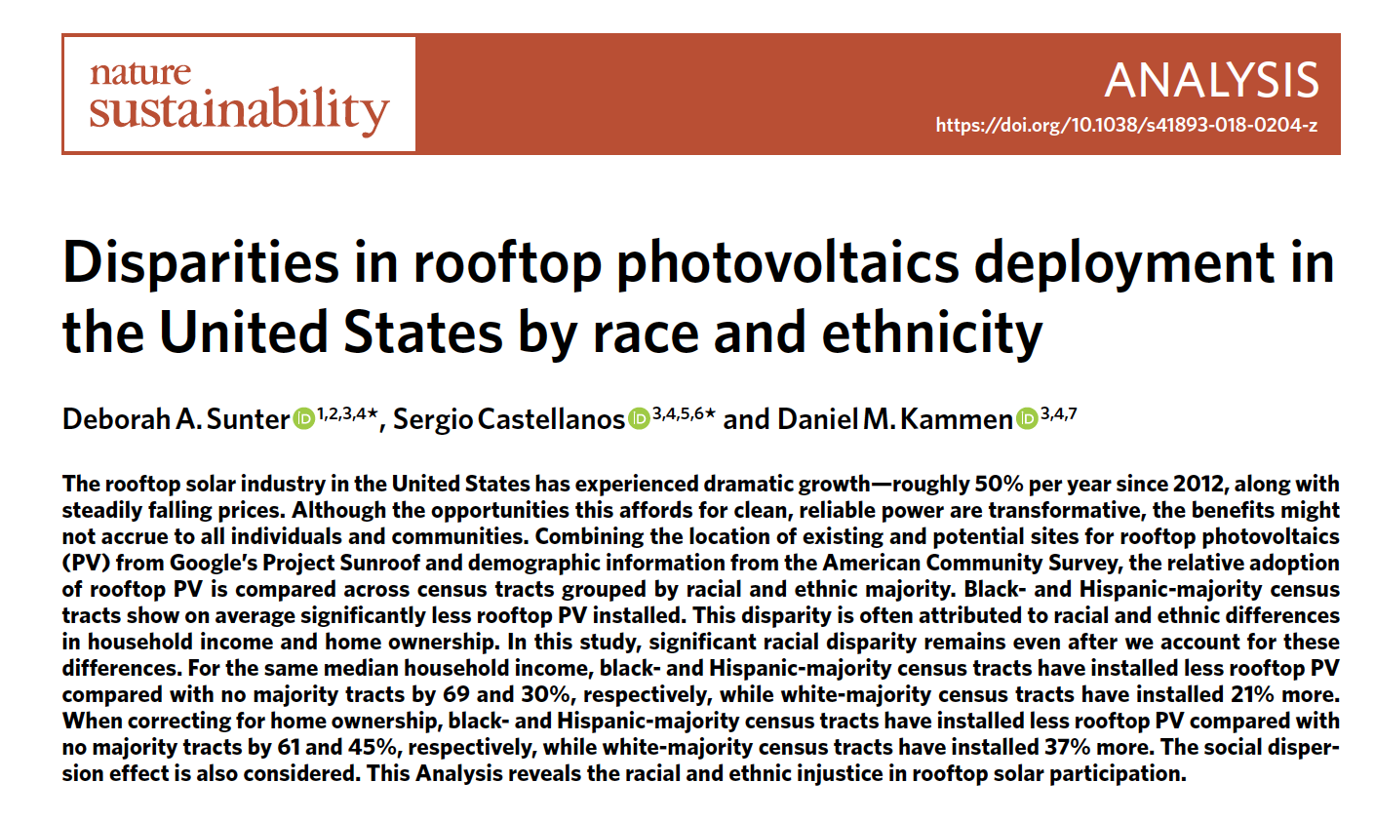
Silicio

Slide 3




Robert Bullard, Dumping in Dixie

Slide 4
Title VI Legislation (2000)
No person in the United States shall, on the ground of race, color, or national origin, be excluded from participation in, be denied the benefits of, or be subjected to discrimination under any program or activity receiving Federal financial assistance.
Note: Clinton Presidency, 1993 - 2001

Slide 5
What is Environmental Justice?
"the fair treatment and meaningful involvement of all people regardless of race, color, national origin, or income with respect to the development, implementation, and enforcement of environmental laws, regulations, and policies. Fair treatment means that no group of people, including a racial, ethnic, or socioeconomic group, should bear a disproportionate share of the negative environmental consequences resulting from industrial, municipal, and commercial operations or the execution of federal, state, local, and tribal programs and policies”
… United States Environmental Protection Agency.

Slide 6
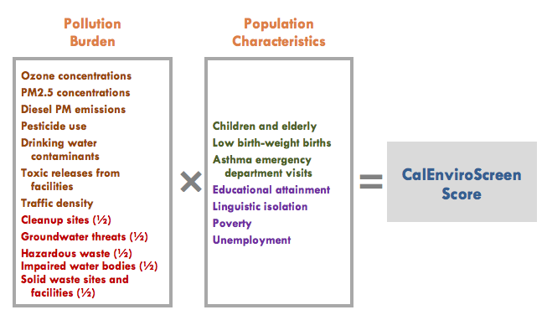
Cal EnviroScreen
http://oehha.ca.gov/calenviroscreen/report/calenviroscreen-version-20

Slide 7
Environmental Justice: Are the impacts of pollution equally faced by different segments of society
(equally faced by which metrics?)
Our question:
Are the benefits of clean energy equally shared by different segments of society?
Silicio

Slide 8
Solar PV’s global market composition
57 GW produced in 2015
Silicio
Image Fraunhofer Institute
A. Feltrin and A. Freundlich. “Material Challenges for Terawatt Level Deployment of Photovoltaics.” 4th World Conference on Photovoltaic Energy Conversion 2016; Hawaii, pg. 2469.

Slide 9
Solar PV’s global market composition
Material options for TW-scale solar PV
57 GW produced in 2015
Thin films:
CIGS, CdTe → Restricted by quantity and toxicity
Te – CdTe: 0.02 TW_{ave} ^{[1]}
In – CIGS: 0.02 TW_{ave} ^{[1]}
Silicon → 2nd most abundant on earth’s crust!
Silicio
Image Fraunhofer Institute
A. Feltrin and A. Freundlich. “Material Challenges for Terawatt Level Deployment of Photovoltaics.” 4th World Conference on Photovoltaic Energy Conversion 2006; Hawaii, pg. 2469.

Slide 10
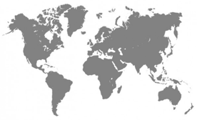
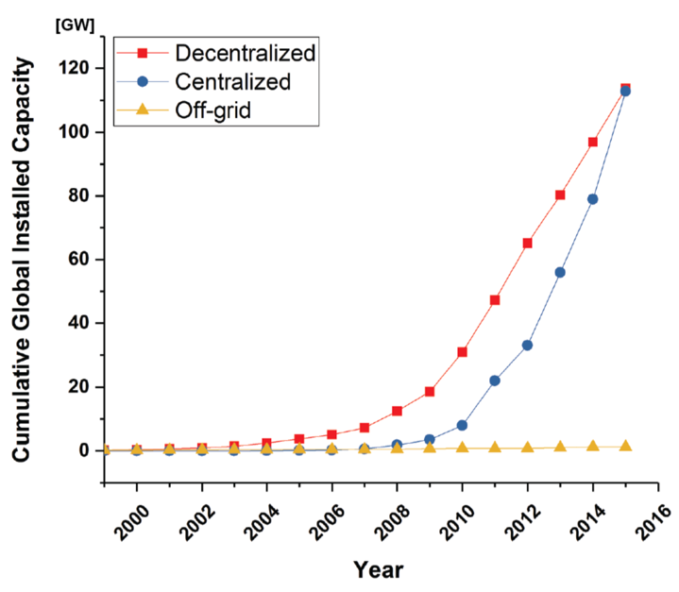
Solar PV: Market Segments
~ 300 GW

Slide 11
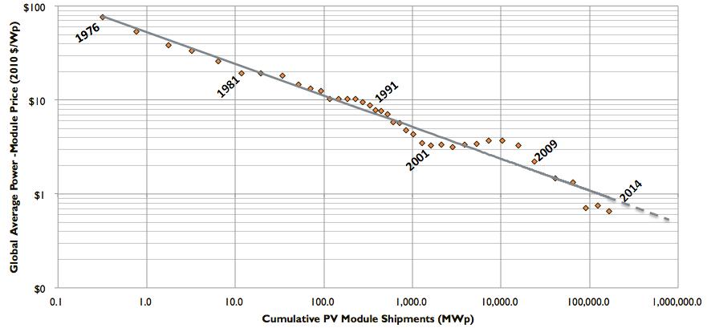
Solar PV: The Classic Experience Curve
Avg. global price
of solar PV modules 2010 [$/Wp]
Paneles solares producidos [MWp]

Slide 12
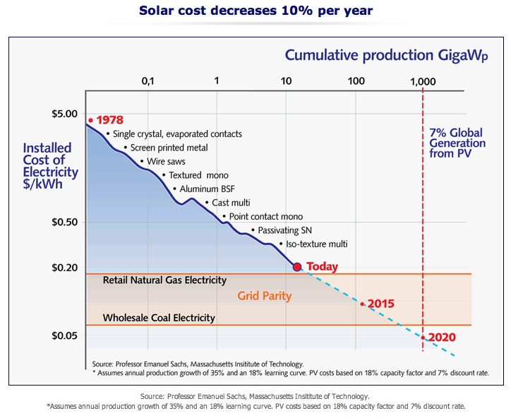

Slide 13
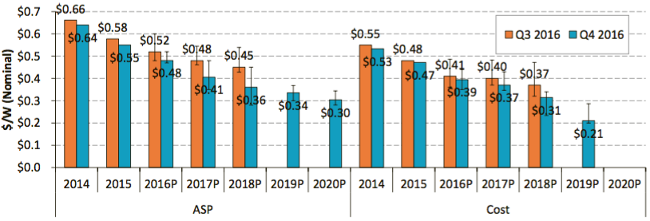
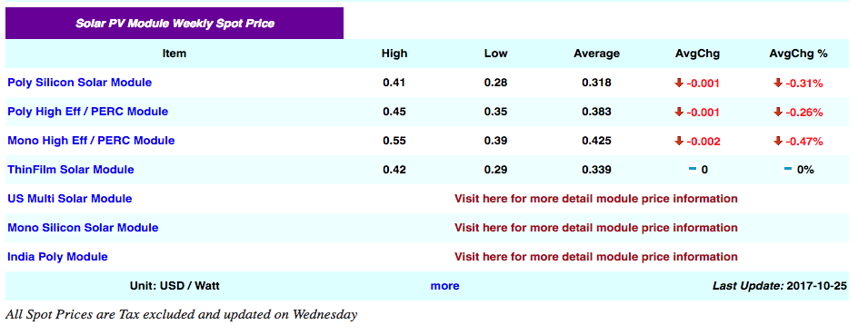
Continued decrease in module prices and costs
Source: SunShot Q3/Q4 2016 Solar Industry Update

Slide 14
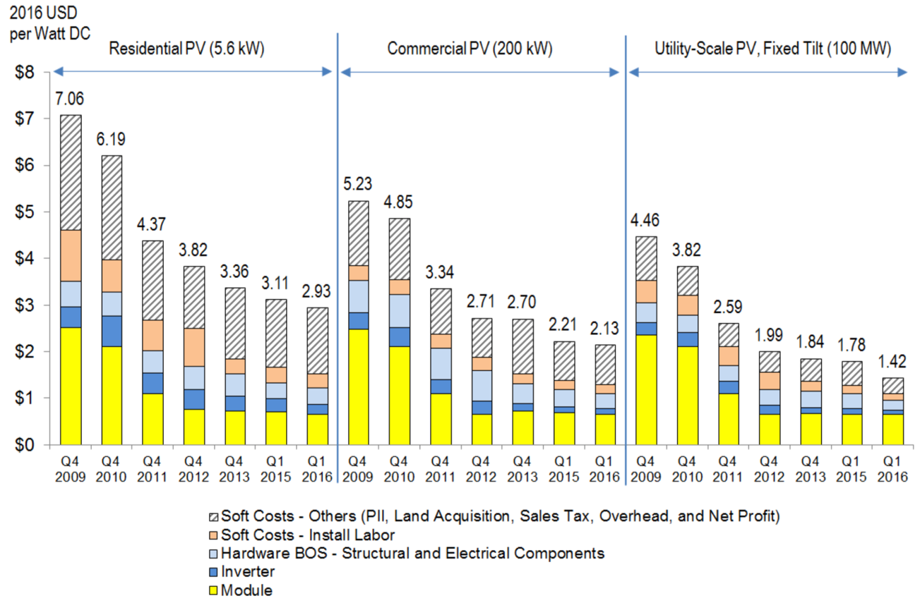
Solar PV: Systems costs structure
Fuente: U.S. Solar Photovoltaic System Cost Benchmark: Q1 2016

Slide 15
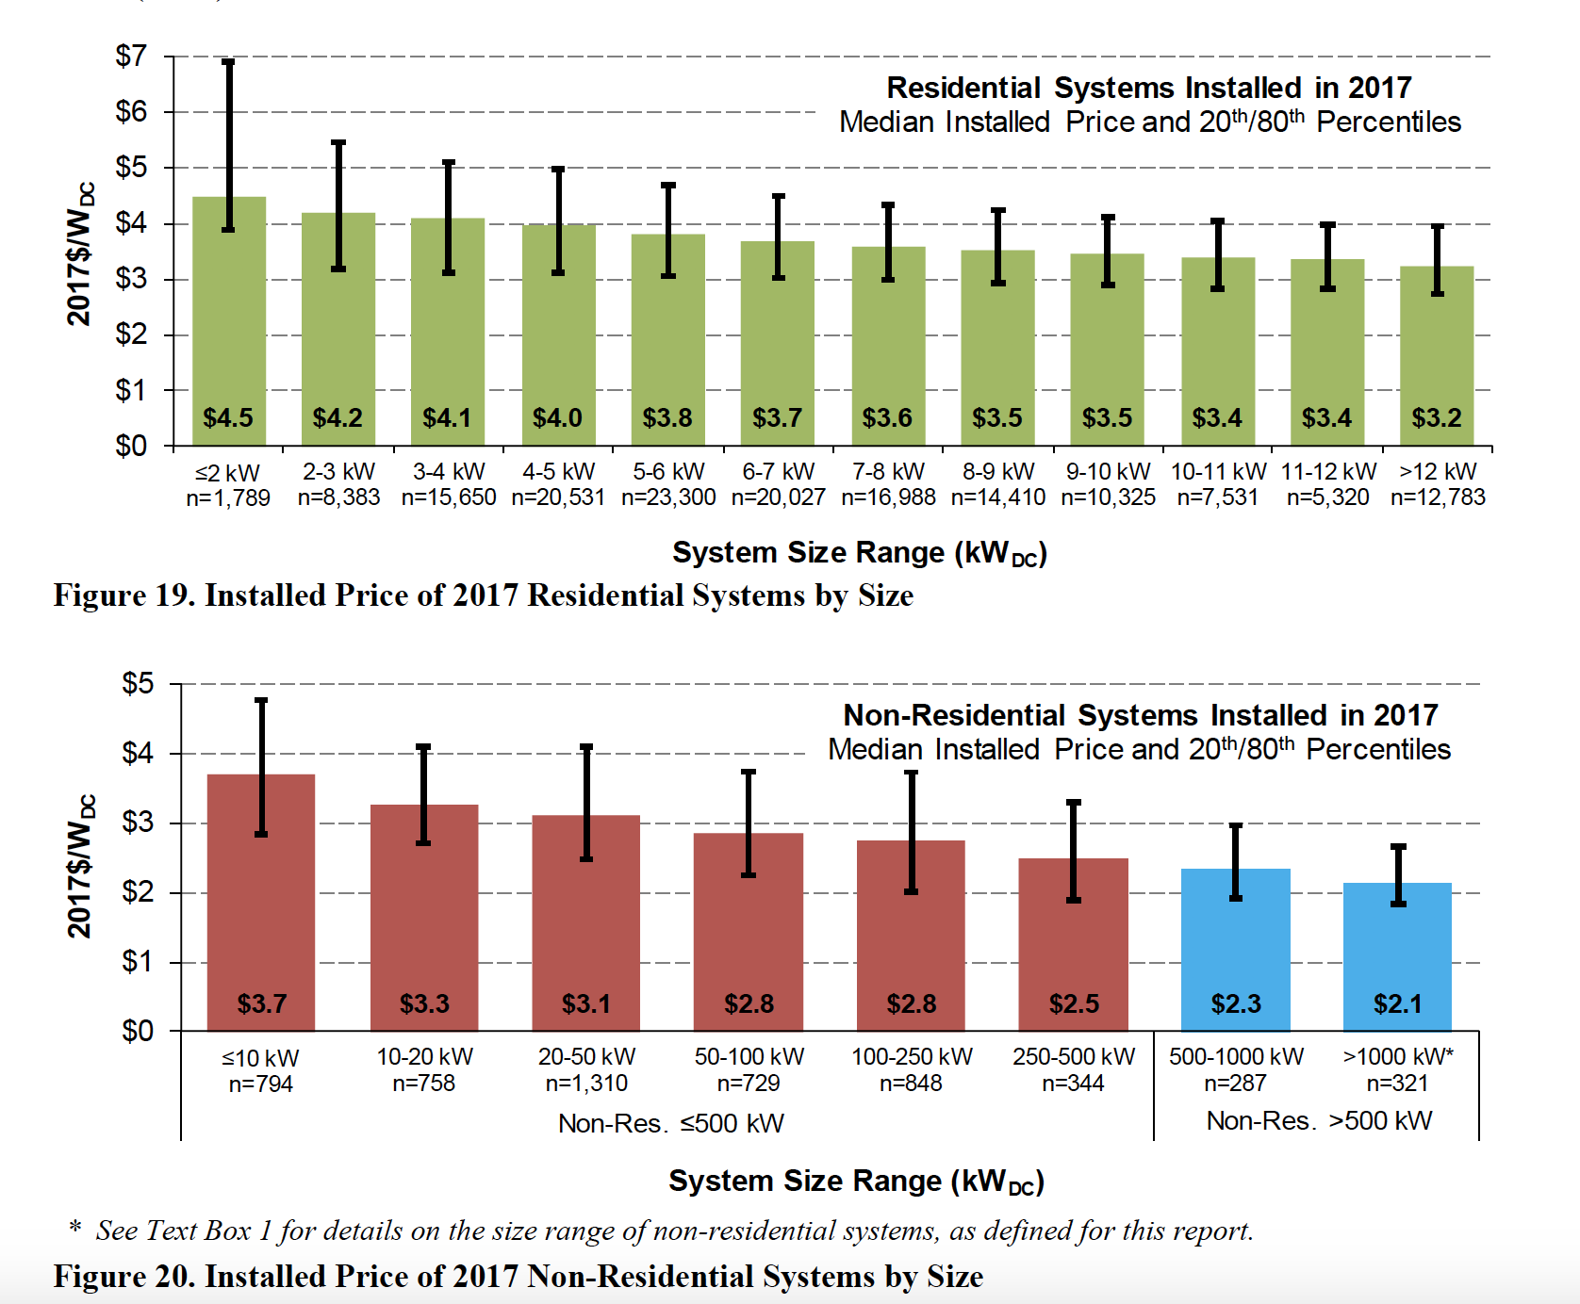
Savings grow with system size

Slide 16
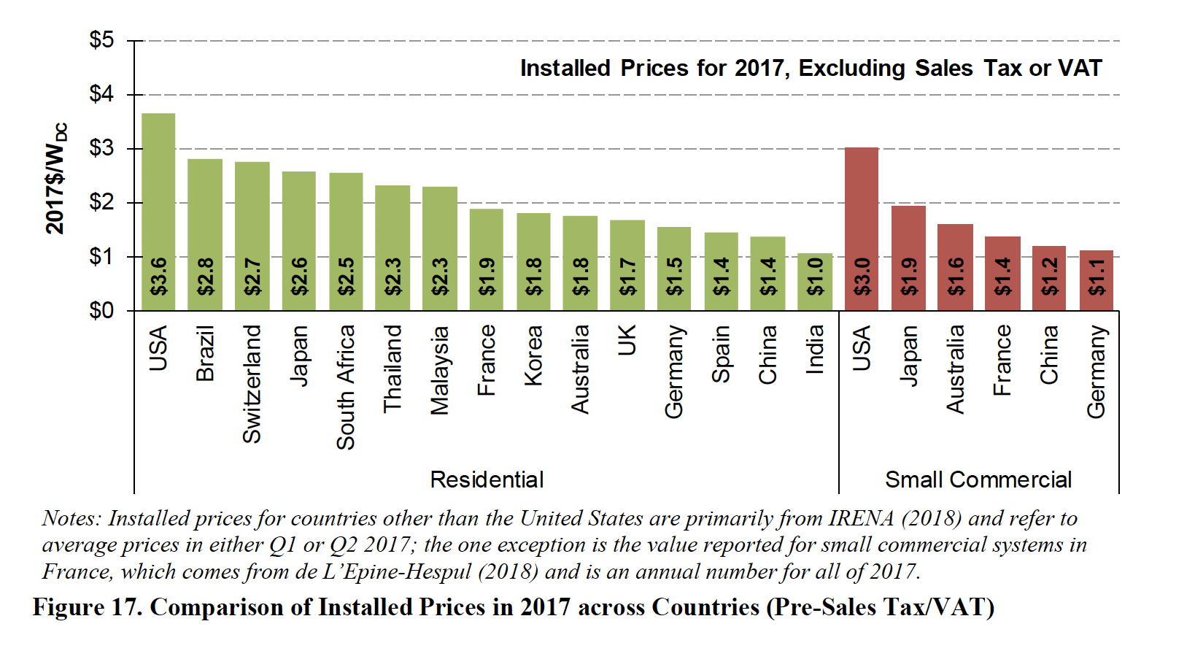
Opportunities for continued savings are huge

Slide 17
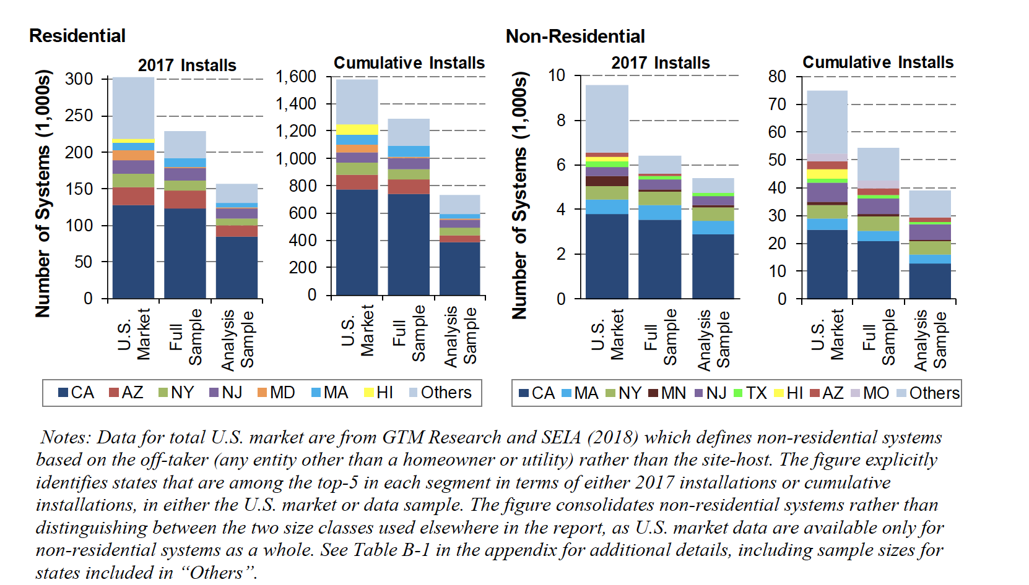
Residential & Non-residential Solar

Slide 18
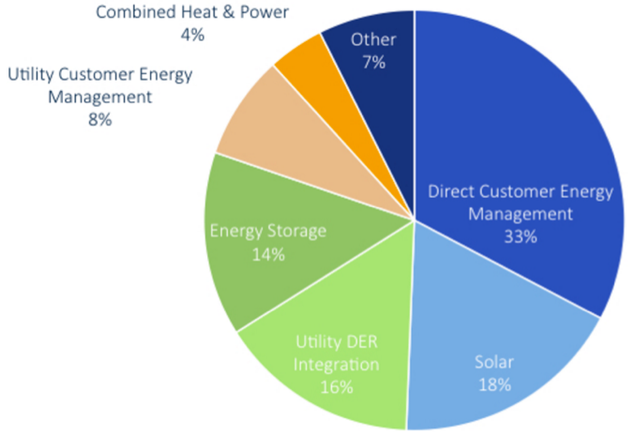
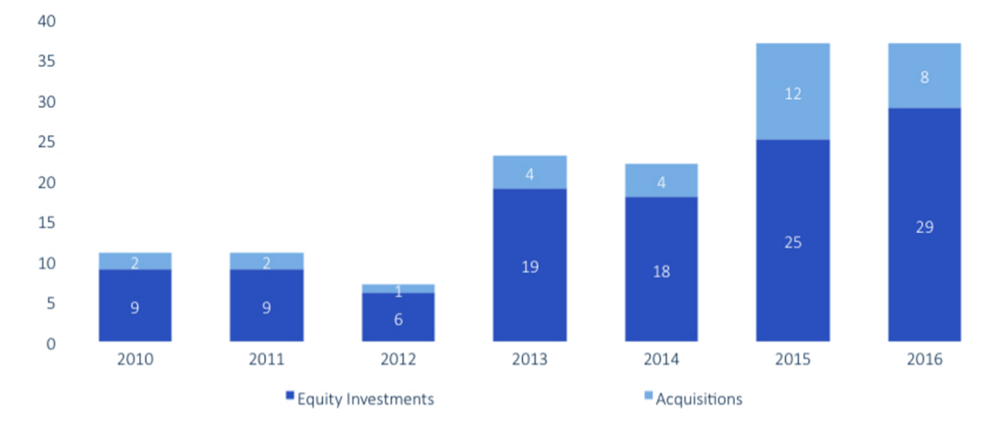
Global increase in DG investments
Globally, Utility investments in
Distributed Energy companies
https://www.greentechmedia.com/articles/read/Californias-Energy-Future-The-Revolution-Might-Be-Distributed

Slide 19
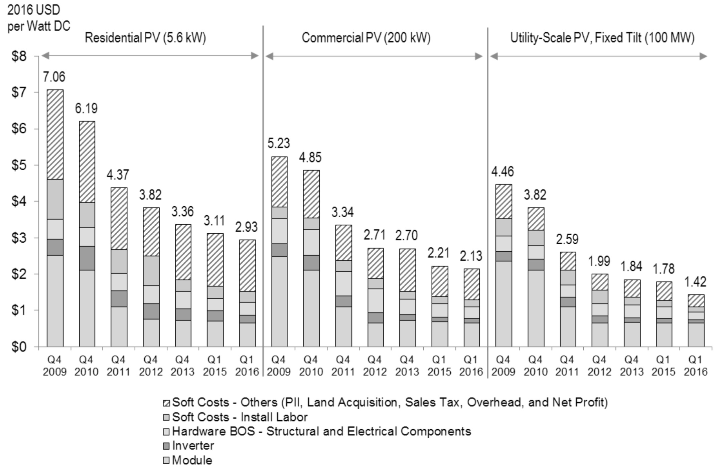
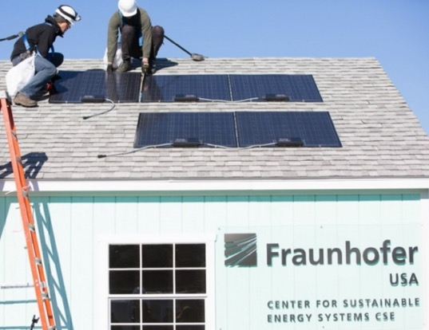
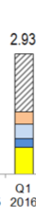
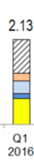
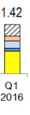
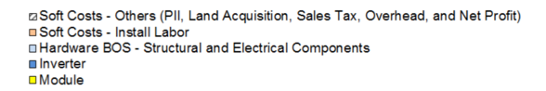
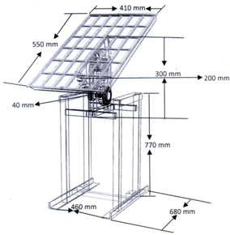

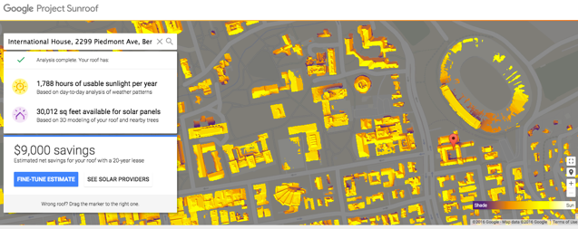
Innovation in Balance of Systems (“BOS”)
https://www.google.com/get/sunroof/data-explorer/
http://www.cse.fraunhofer.org/pnp
https://www.google.com/get/sunroof#p=0

Slide 20
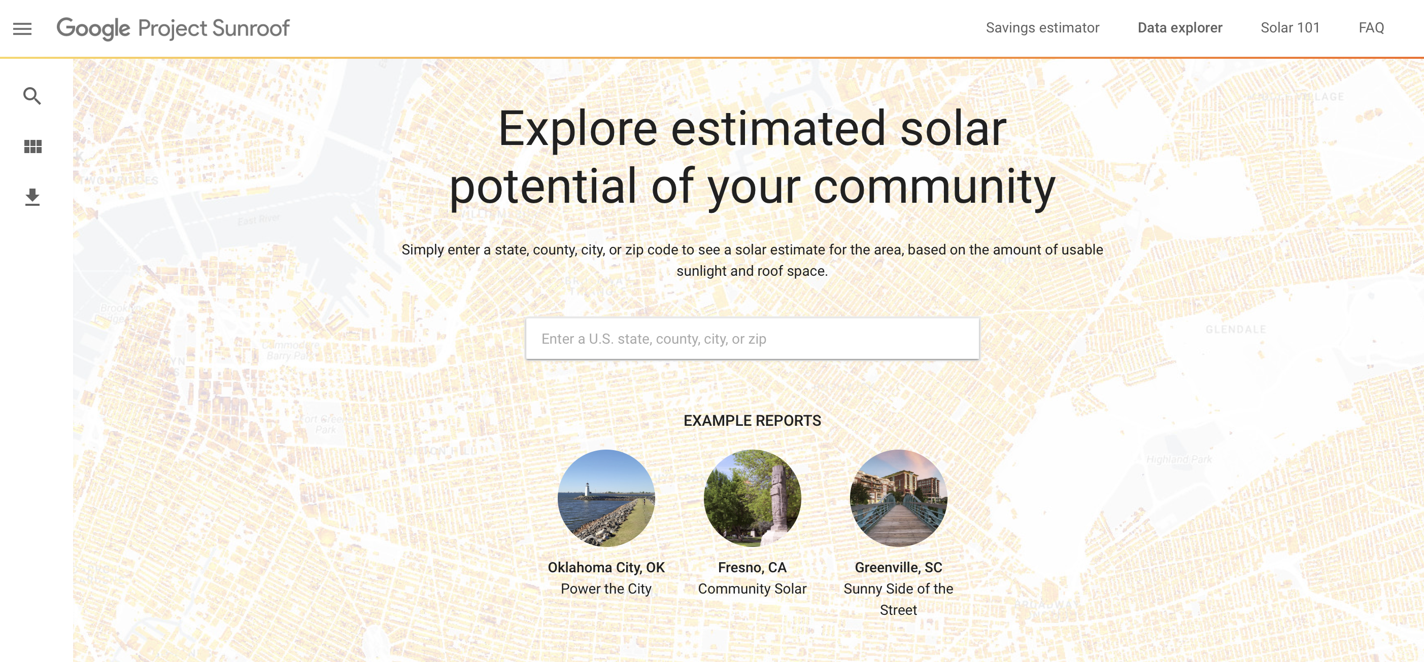
https://www.google.com/get/sunroof/data-explorer/

Slide 21
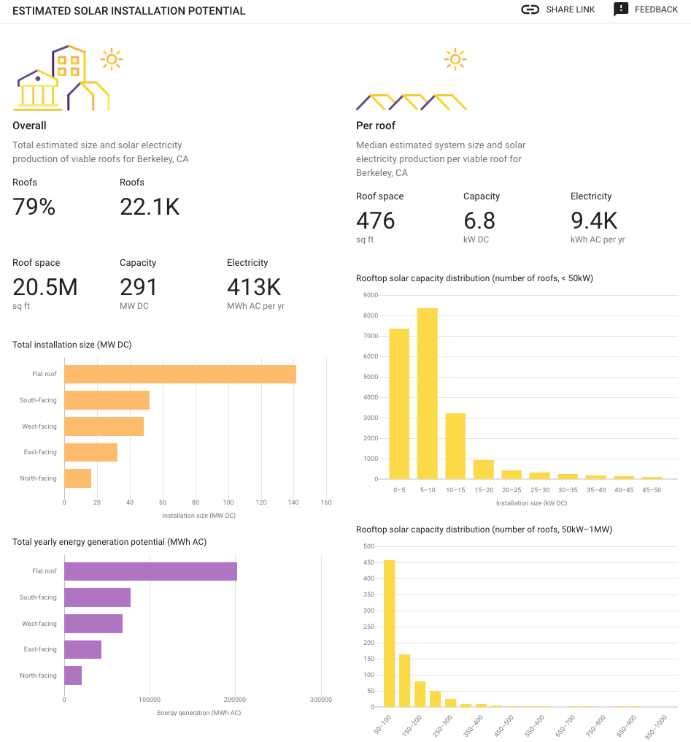
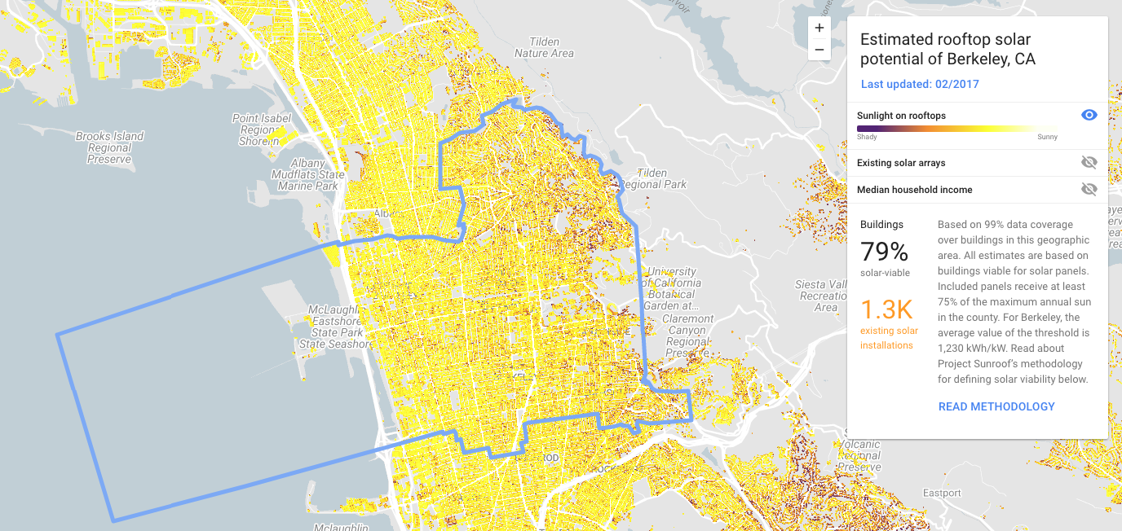
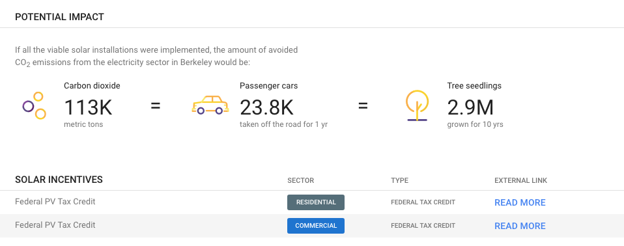

Slide 22
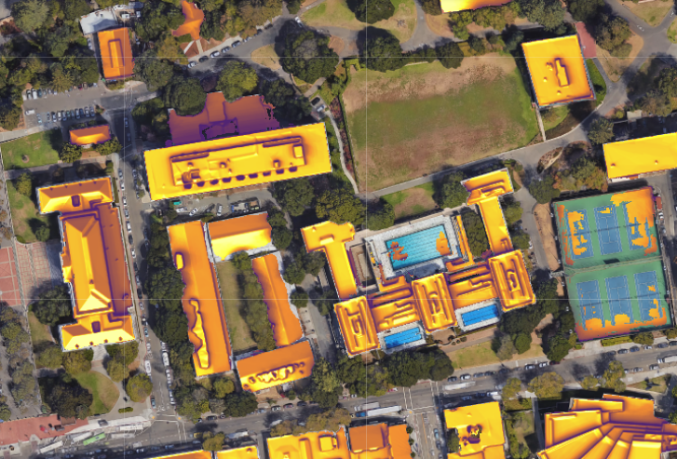
Data check: UCB Campus

Slide 23
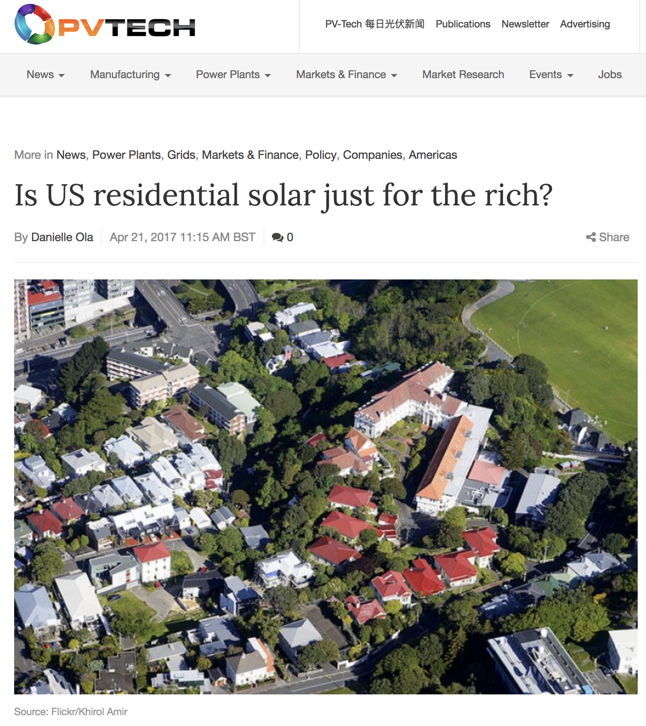
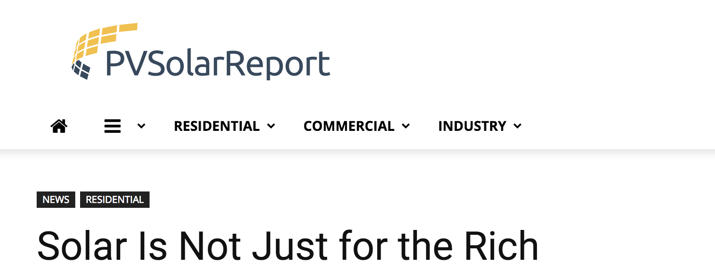
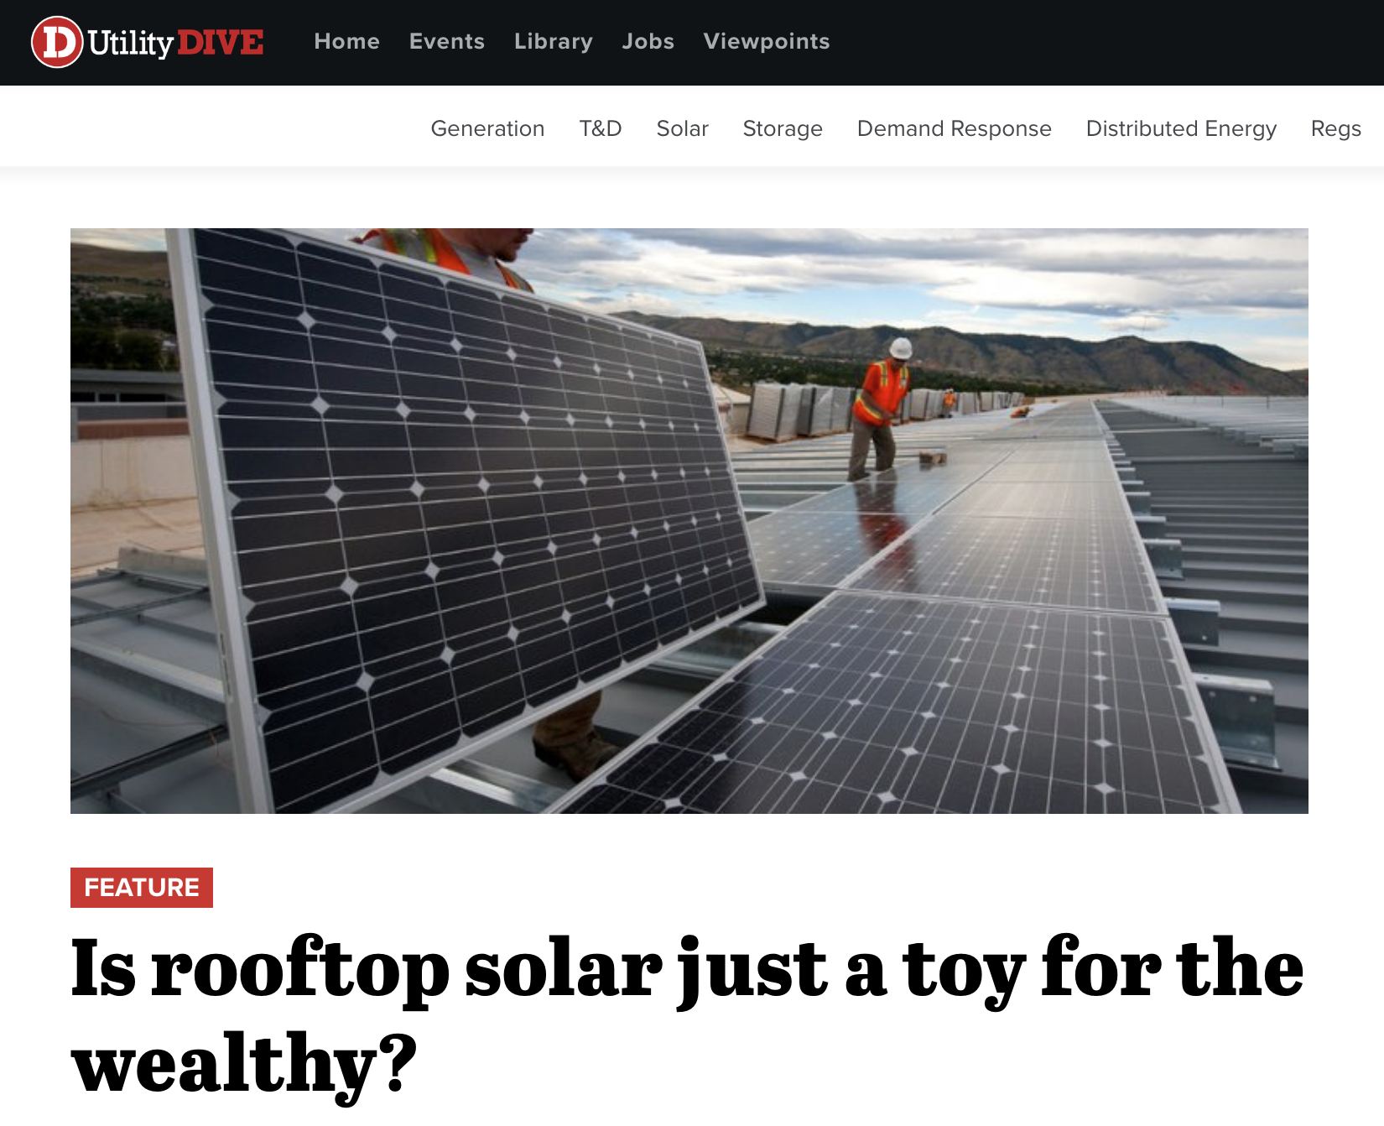
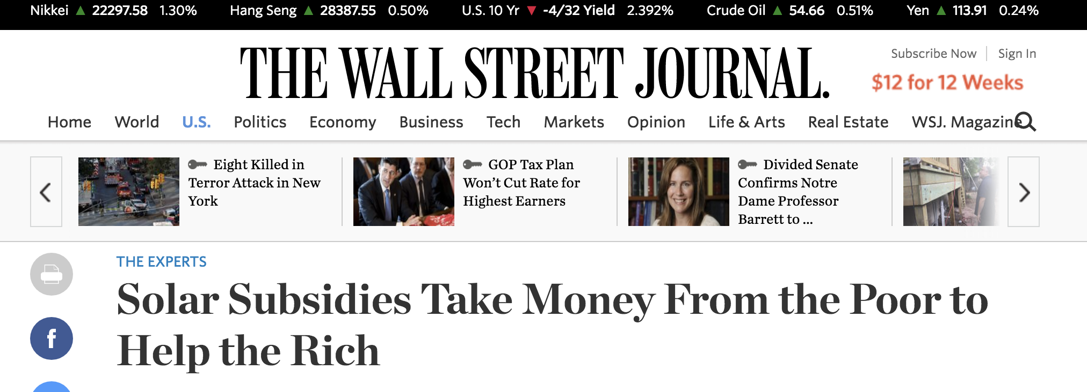

Slide 24

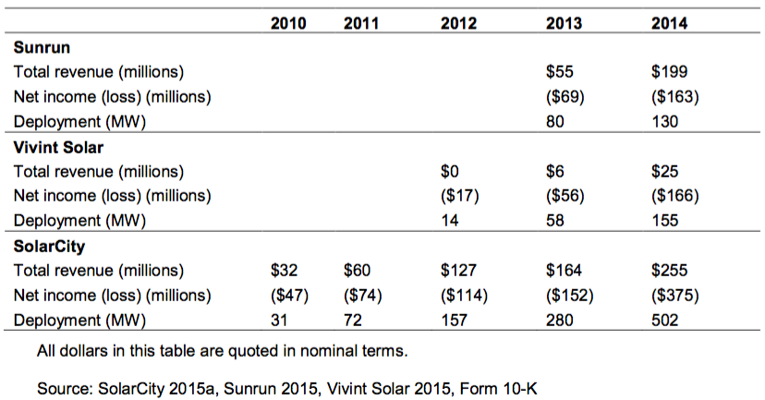
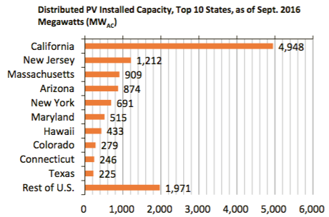
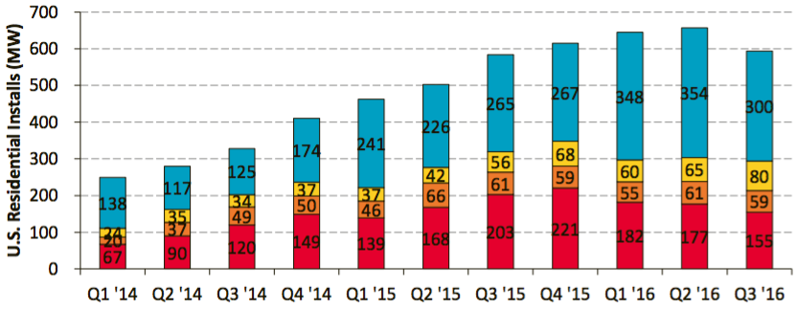
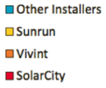
Rooftop PV:
75% installations post-2011
~50% market: 3 companies.
27.9 GW AC ₍₂₀₁₆₎
15.6 GW Centralized
12.3 GW Distributed
On the path to SunShot:
Emerging Opportunities and Challenges in Financing Solar, NREL 2016
SunShot US Solar Industry Update Q4 2016
Notes:
Interest rates creeping up

Slide 25
Over-arching Questions
How equitable has the Rooftop Solar PV adoption been?
Are there any signs of disparity in adoption among ethnic groups/races?

Slide 26
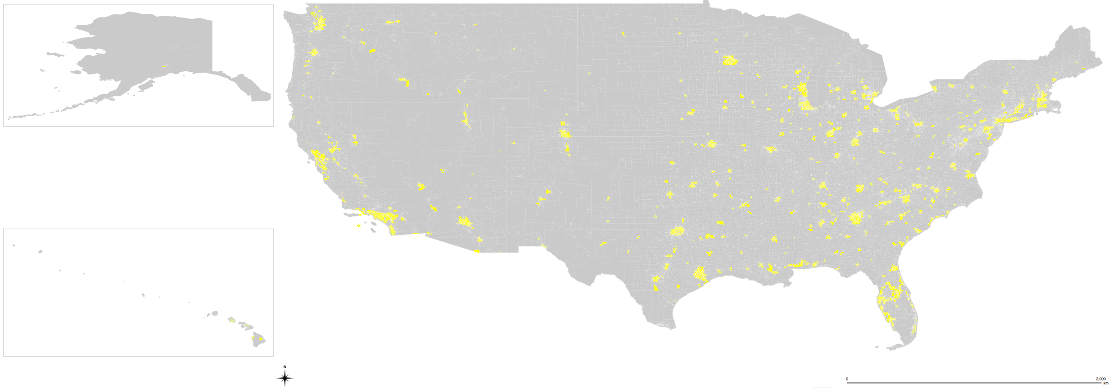
Data: Google Sunroof Project (50 states, +60M bldgs.)

Slide 27
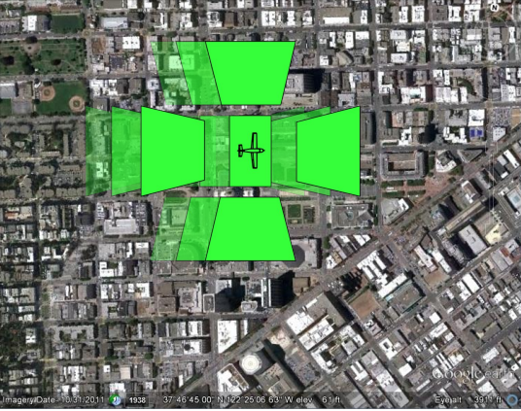
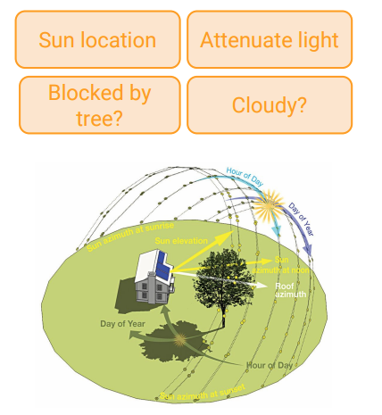
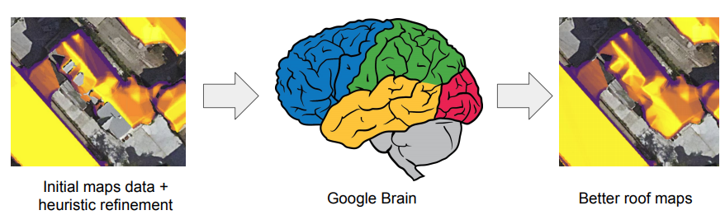
Sunroof’s Data
Millions of oblique images acquired, processed, and refined.
Images: Joel Conkling – Philomathia Forum presentation on Google Sunroof

Slide 28
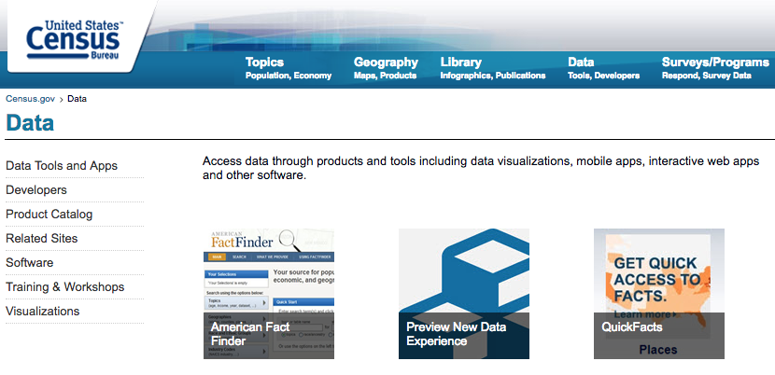
Approach: PV + Income Demographics
American
Community
Survey
(ACS)
5 yrs. estimates
2010–2014
Only coverage of 95% accounted
Segregation cleaning

Slide 29
Data cleaning
Python (scrips available)
Census Tract Solar Deployment Performance =
Number of Existing Solar Panels /
Total Number of Potential Solar Panels
State Normalized Solar Deployment =
Census Tract Solar Deployment Performance /
Average Census Tract Solar Deployment Performance in that State
Smoothing the data
Locally weighted scatterplot smoothing estimator (LOWESS) method
Bootstrapping 1000x/income segment

Slide 30
Bootstrapping (resampling): determine mean w/o function
Consider a coin-flipping experiment. We flip the coin and record whether it lands heads or tails.
Let X = x₁, x₂, …, x₁₀ be 10 observations from the experiment.
x_{i} = 1 if the i th flip lands heads, and 0 otherwise.
From normal theory, we can use t-statistic to estimate the distribution of the sample mean, x_{avg} = (1/10) (x₁ + x₂ + … x_{n})
Instead, we can use bootstrap, specifically case resampling, to derive the distribution of b(x_{avg})
We first resample the data to obtain a bootstrap resample.
An example of the first resample might look like this
of b(x_{avg}) = X₁* = x₂, x₁, x₁₀, x₁₀, x₃, x₄, x₆, x₇, x₁, x₉.
And then repeat

Slide 31
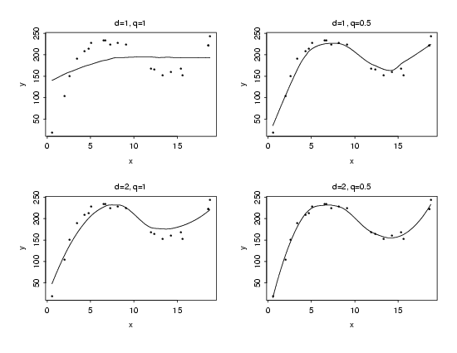
Locally weighted scatterplot smoothing estimator (LOWESS)
What is Lowess Smoothing used for?
Fitting a line to a scatter plot or time plot where noisy data values, sparse data points or weak interrelationships interfere with your ability to see a line of best fit.
Linear regression where least squares fitting doesn’t create a line of good fit or is too labor-intensive to use.
Data exploration and analysis in the social sciences, particularly in elections and voting behavior.
The smoothing parameter, (d+1)/n < q < 1
with
d the degree of the local polynomial.
q is the proportion of data used in each fit.
The subset of data used in each weighted least squares fit is comprised of the nq

Slide 32
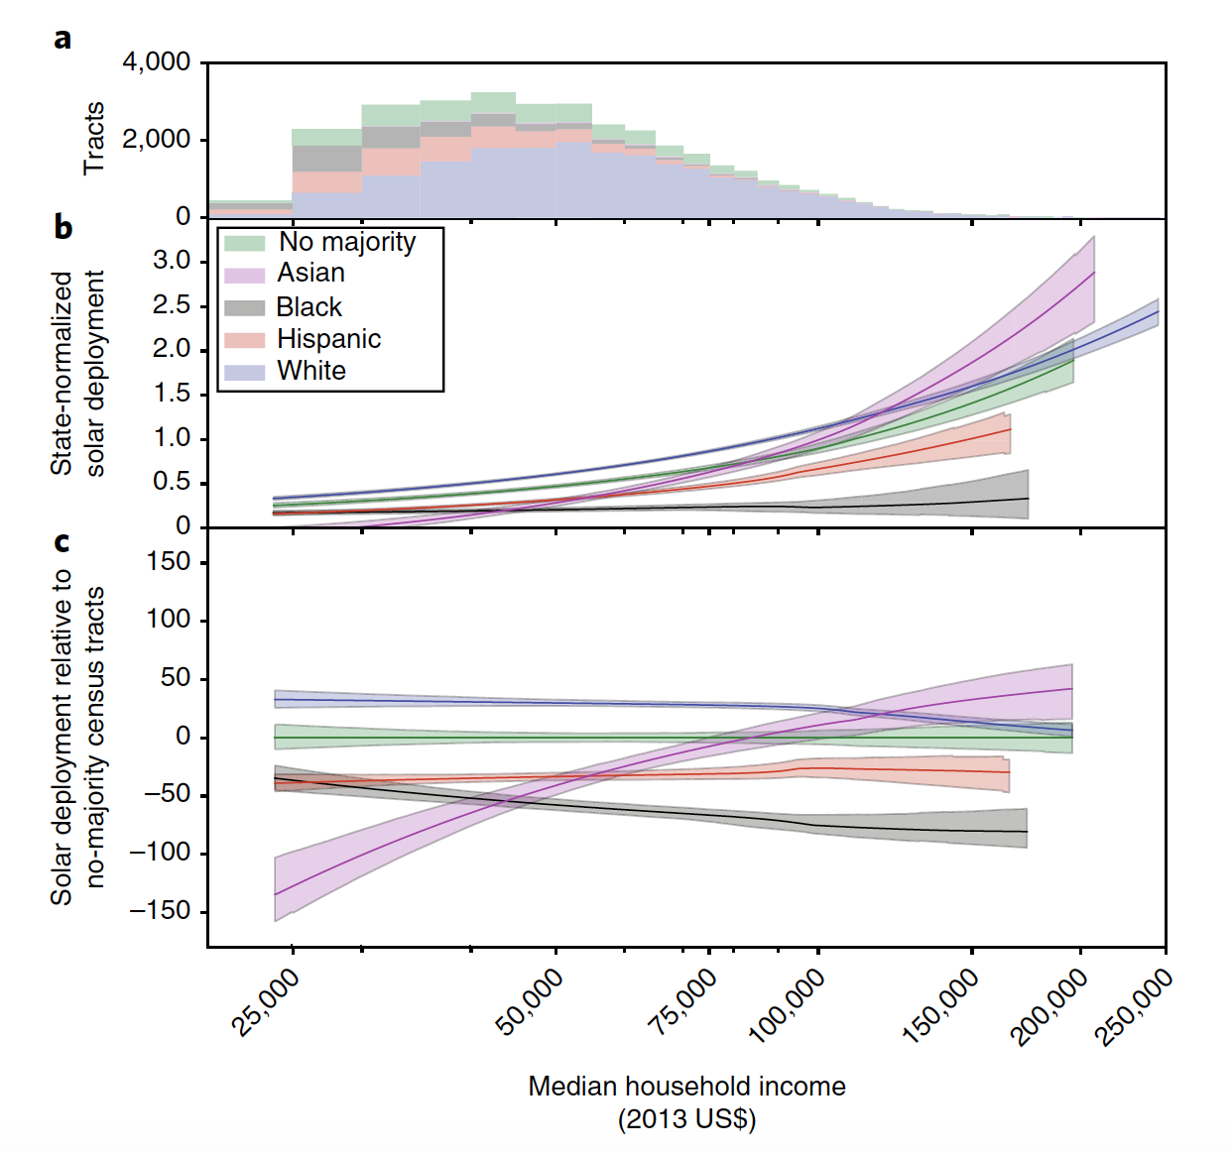
Racial disparity is observed – even at same income

Slide 33
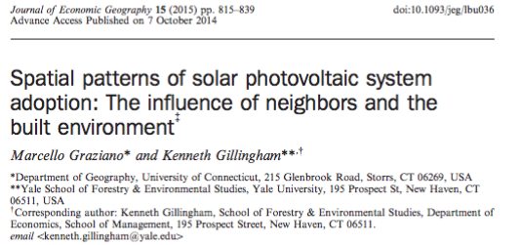
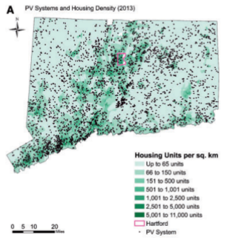
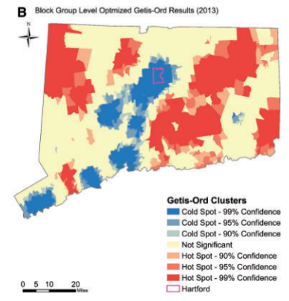
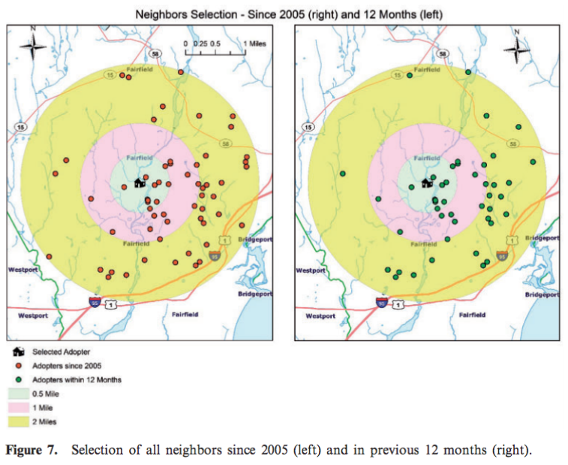

Slide 34
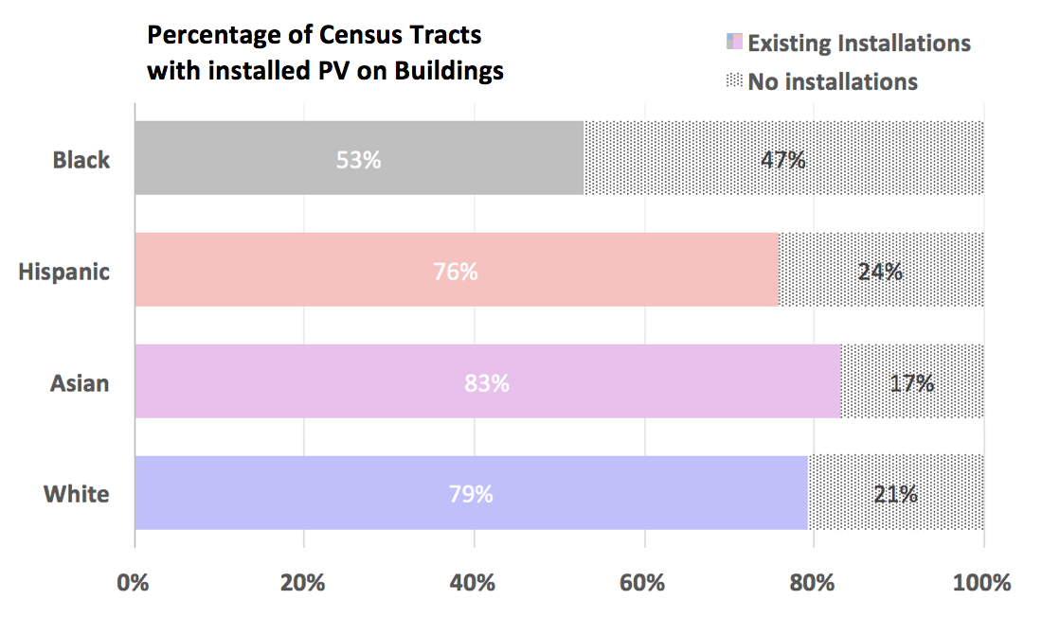
A significant amount of tracts lack PV installations

Slide 35
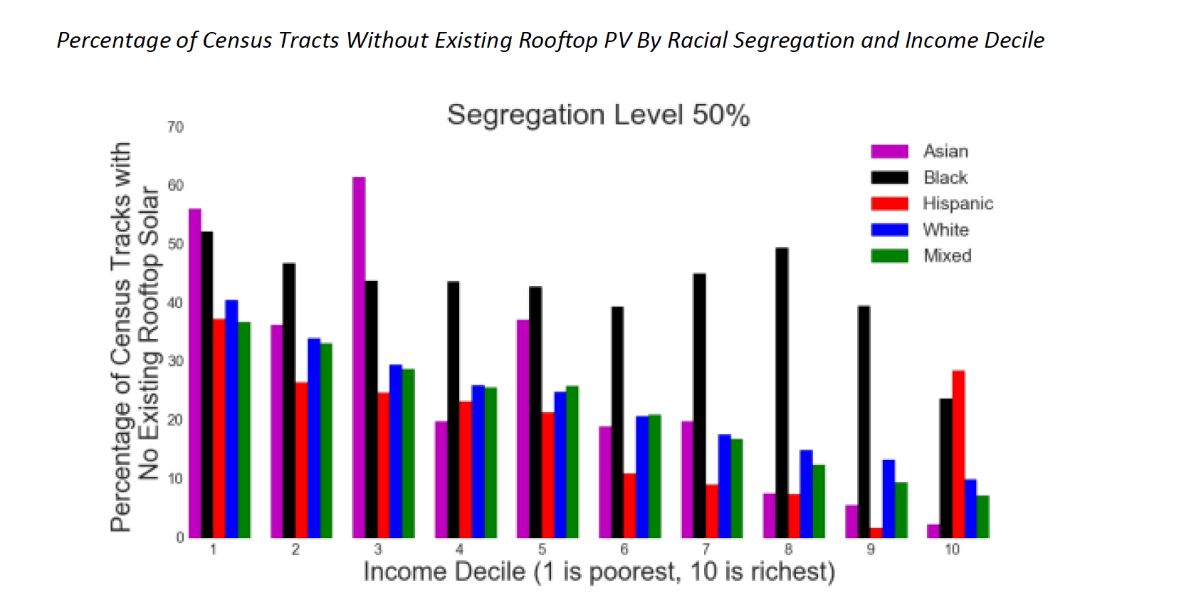
A significant amount of tracts lack PV installations

Slide 36
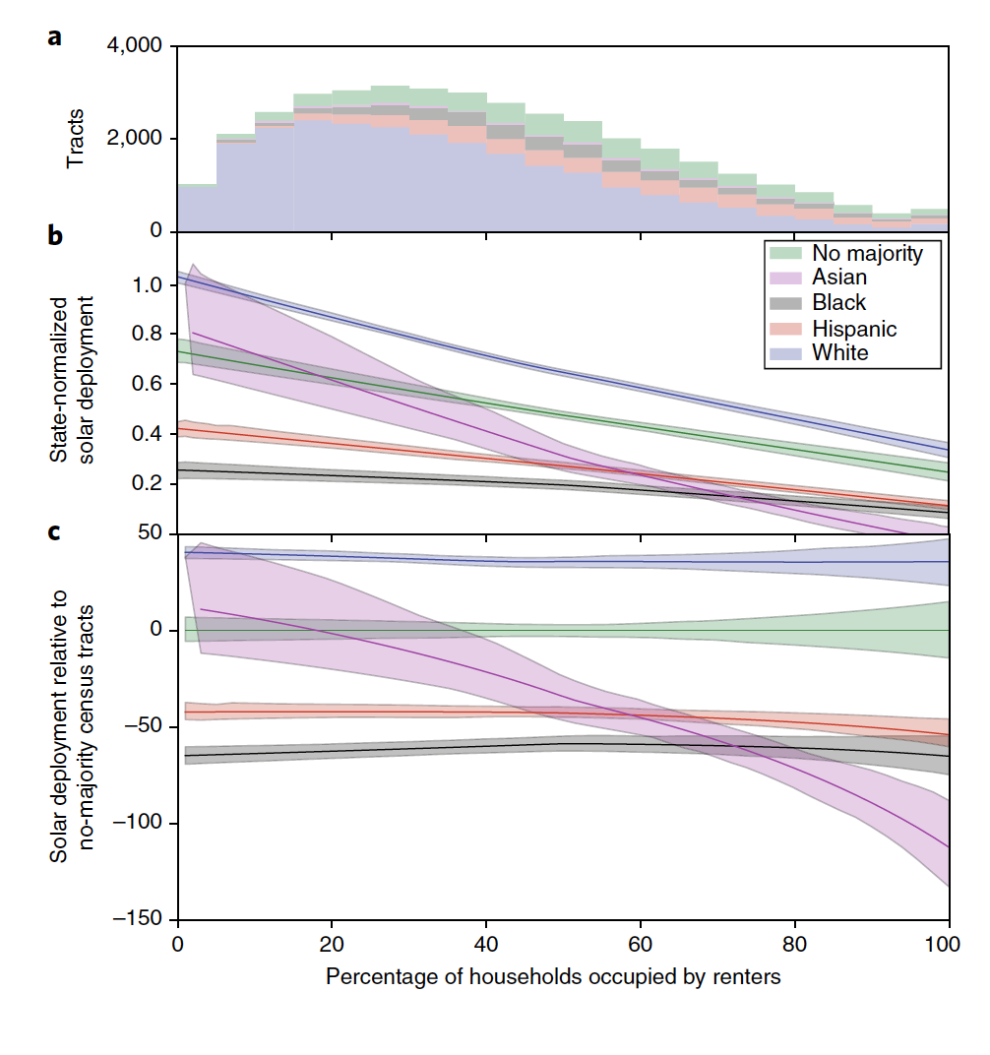
As a function of dwelling rental

Slide 37
Follow-up
DoE SunShot Webinar (> 800 participants)
Summarize findings
Share python code
Excerpted Version: The Beam
National Public Radio, Scientific American, Forbes …
Sanders & Warren campaigns
New papers in progress on: solar by party affiliation;

Slide 38
Opportunities
Academia
Understand and further study root causes of observed disparity
Leverage power of increasingly available datasets to spur discussions with both Industry and Government
Industry
Business models that leverage on the observed gap
Racial distribution in employees and customer acquisition process
Government
Tailored policy interventions that target segregated tracts
Create/modify incentives for PV deployment

Slide 39
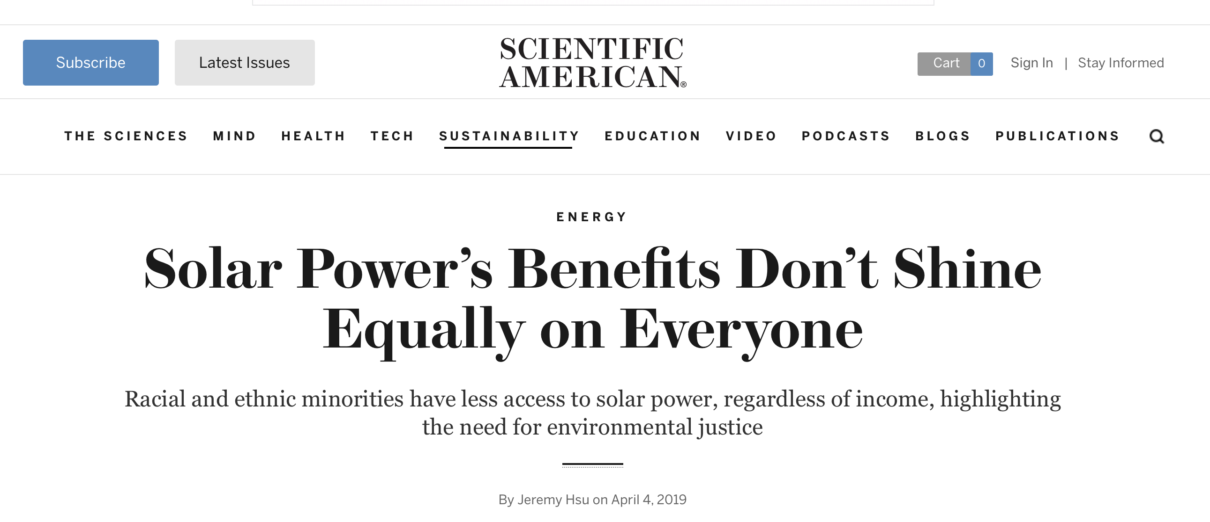

Conversation:
https://www.scientificamerican.com/article/solar-powers-benefits-dont-shine-equally-on-everyone/
https://www.npr.org/2019/07/23/741952615/stepping-into-the-sun-a-mission-to-bring-solar-energy-to-communities-of-color

Slide 40

Devices or Systems?
Schmidt, et al, (2017) “The future cost of electrical energy storage based
on experience rates“, Nature Energy

